Slide 1
Introduction to variability of flows and concentrations in watersheds using R markdown
BAE204, 1 April 2021

Slide 2
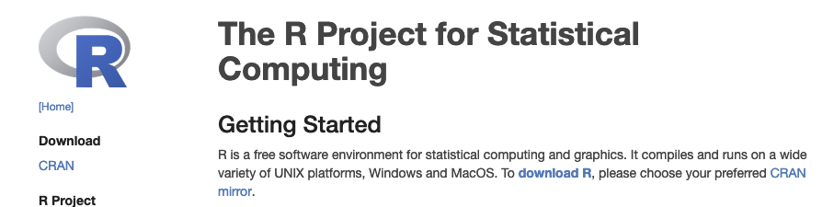
Download R
Google: ‘R project’
http://archive.linux.duke.edu/cran/

Slide 3

Download RStudio
Google: ‘rstudio download’

Slide 4
Using R to make websites, write books and articles
Websites
Articles
Books, chaptered docs

Slide 5
What’s this ***down business?
It starts with Markup language!

Slide 6
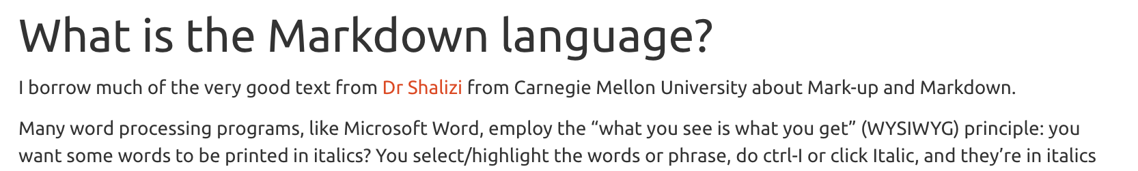
What is the Markup language?
<div id="what-is-the-markdown-language" class="section level2"> <h2>What is the Markdown language?</h2> <p>I borrow ... from <a href="http://www.stat.cmu.edu/~cshalizi/rmarkdown/">Dr Shalizi</a> from ...</p> <p>Many ...that of <em>marking up</em> text. The essential idea in a <strong>mark-up language</strong> is that it consists of ordinary text, <em>plus</em> signs which indicate how to change the formatting or meaning of the text. Some mark-up languages, like HTML (Hyper-Text Markup Language) use very obtrusive markup; others, like the language called <strong>Markdown</strong>, are more subtle.</p> </div>

Slide 7
Markup, Markdown
Play on word!
Markup: a bit on the complicated side (HTML, LaTeX, others)
Markdown: the idea is to make things simple:
<div id="what-is-the-markdown-language" class="section level2"> <h2>What is the Markdown language?</h2>
Becomes
## What is the Markdown language?

Slide 8
One code, several output formats
Markdown .md format recognized by many interpreter codes
Rmarkdown example outputs:
Documents:
Html documents
Pdf document (via LaTeX)
Word document
epub
Presentations:
Ioslides_presentations
Power point presentations
Other:
Interactive dashboards
Github_documents

Slide 9
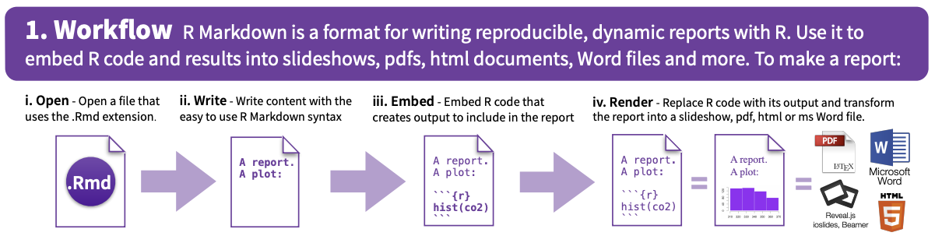
https://www.rstudio.com/wp-content/uploads/2015/02/rmarkdown-cheatsheet.pdf

Slide 10
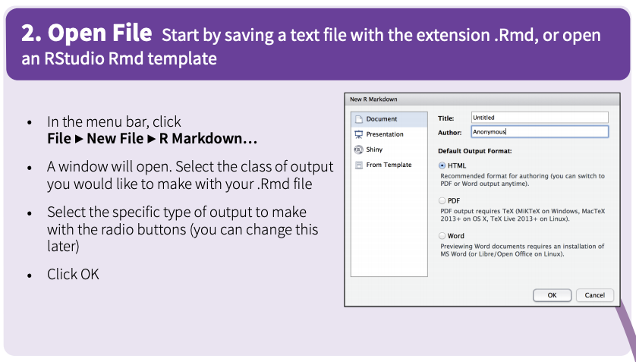

Slide 11
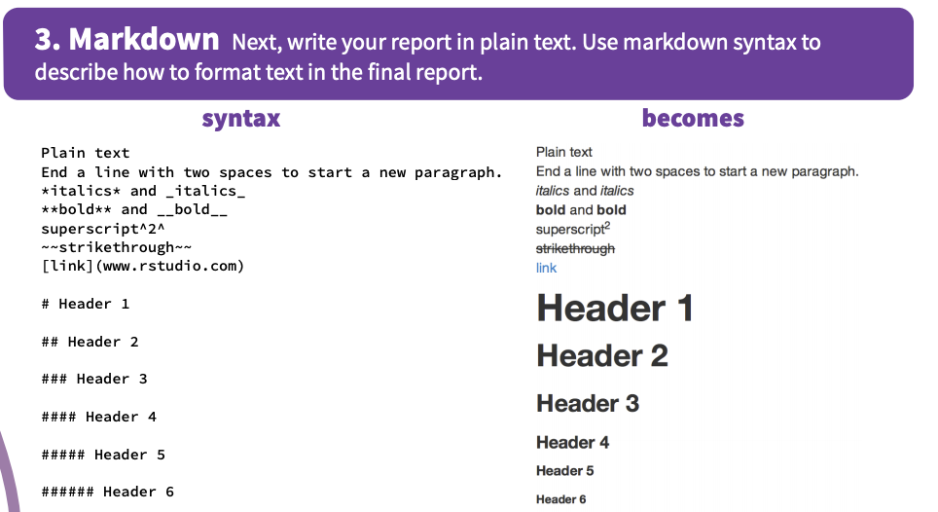

Slide 12
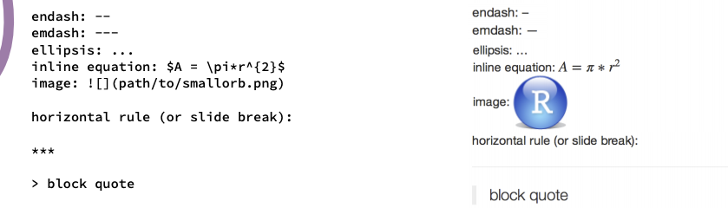

Slide 13
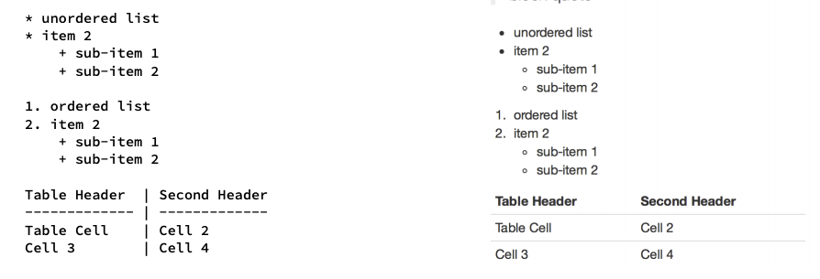

Slide 14
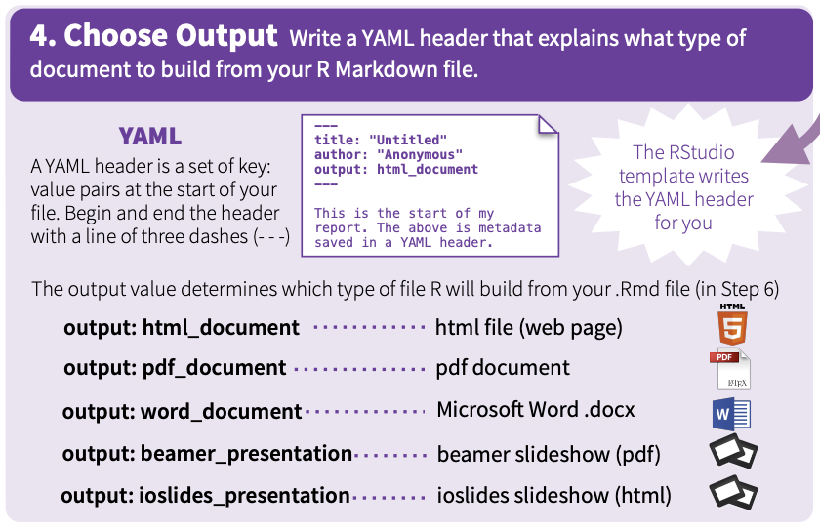

Slide 15
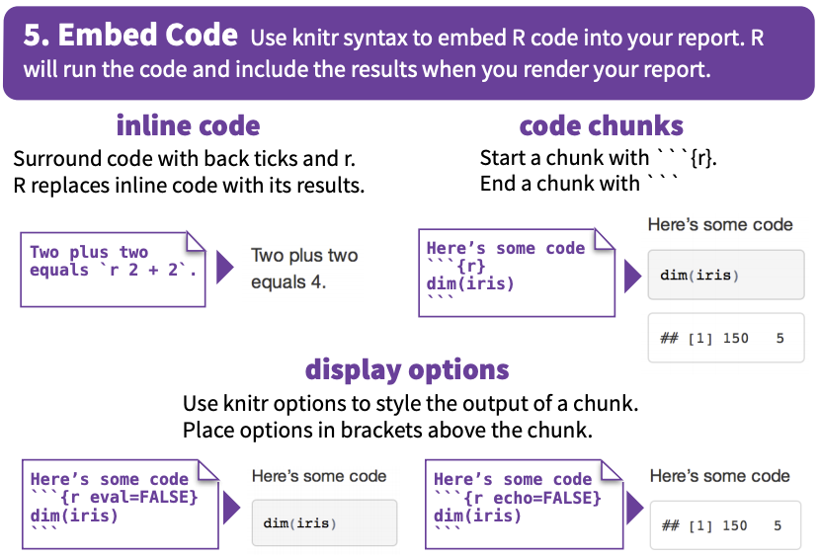

Slide 16
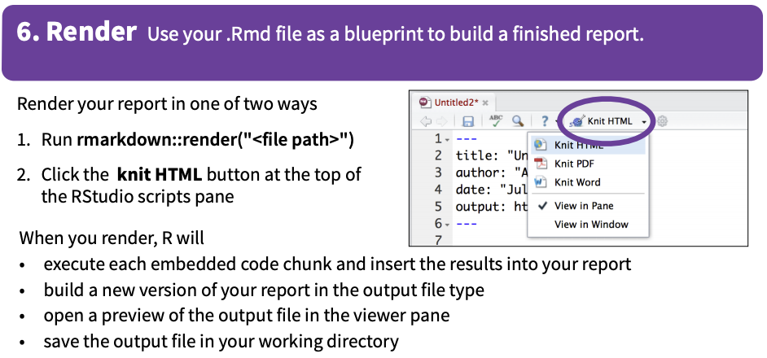

Slide 17
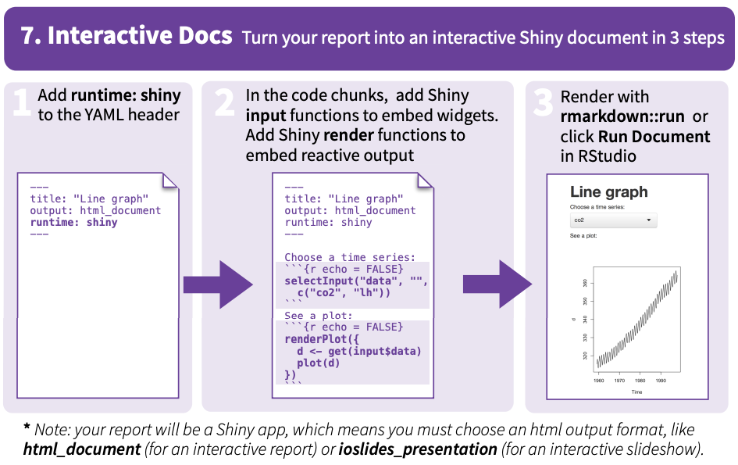

Slide 18


Slide 19
The basic structure
YAML header
Defines settings for the document
Text
Headings, alteration, cross-references, etc.
Code chunks
Interprets codes in R, python, C, and fortran
Rmarkdown, Bookdown, and blogdown KNIT all pieces together in homogeneous output

Slide 20
Rmarkdown starter
Go to https://github.com/francoisbirgand
Go to repositories
Choose BAE204-Qlab
(https://github.com/francoisbirgand/BAE204-Qlab)
Download ZIP

Slide 21
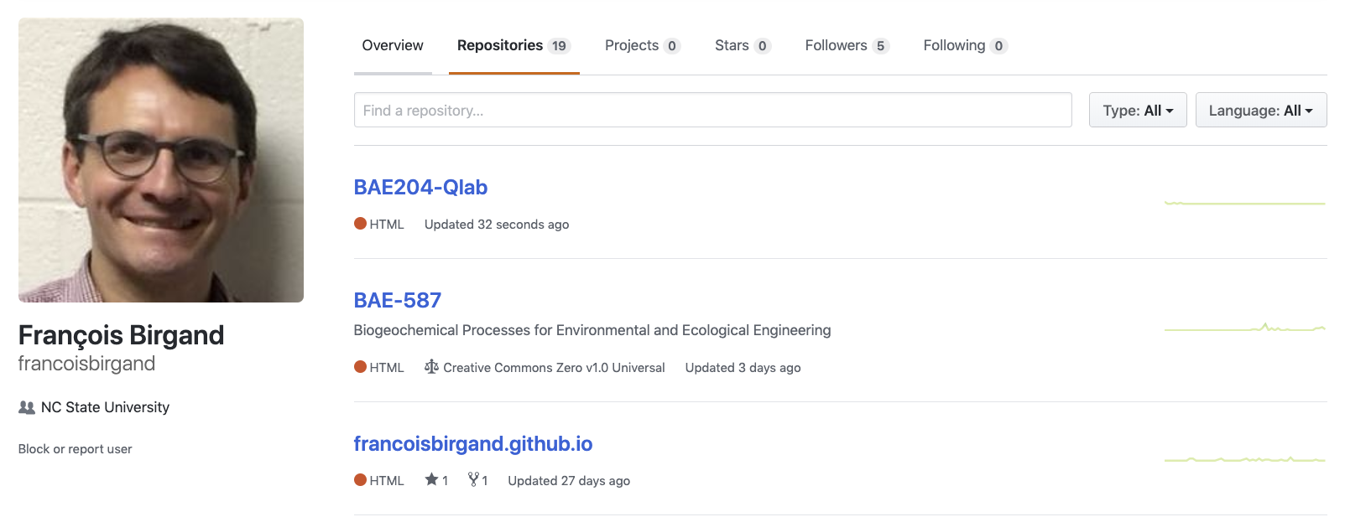

Slide 22
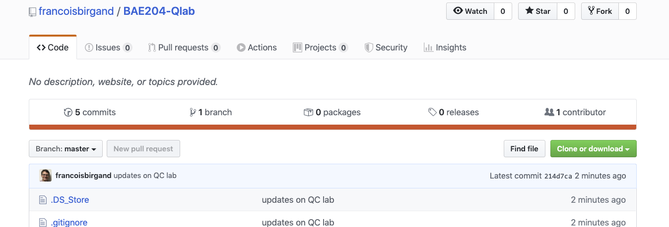

Slide 23
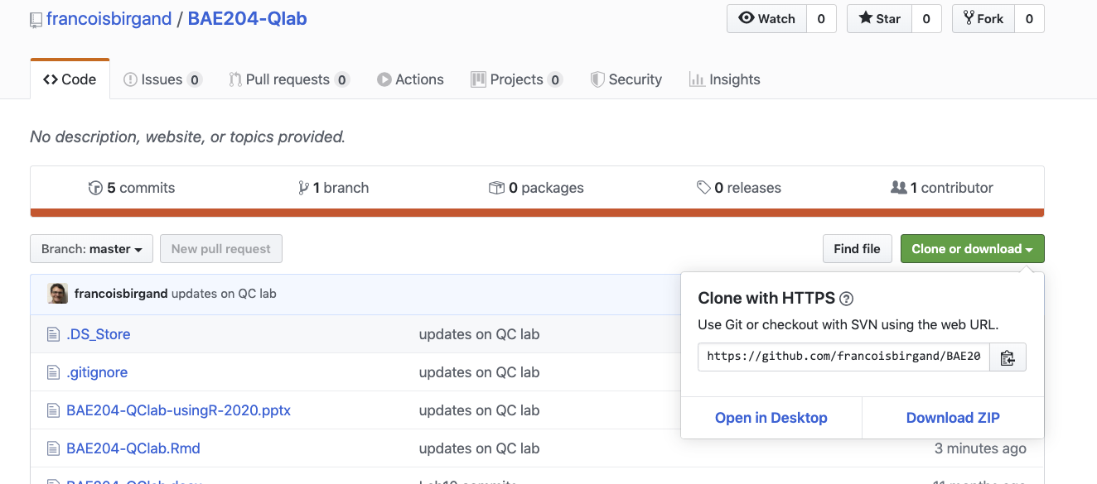

Slide 24
Unzip the file into a directory of your choice
In that directory, open the QClab.Rproj file
Normally, your screen should look like on the next slide

Slide 25
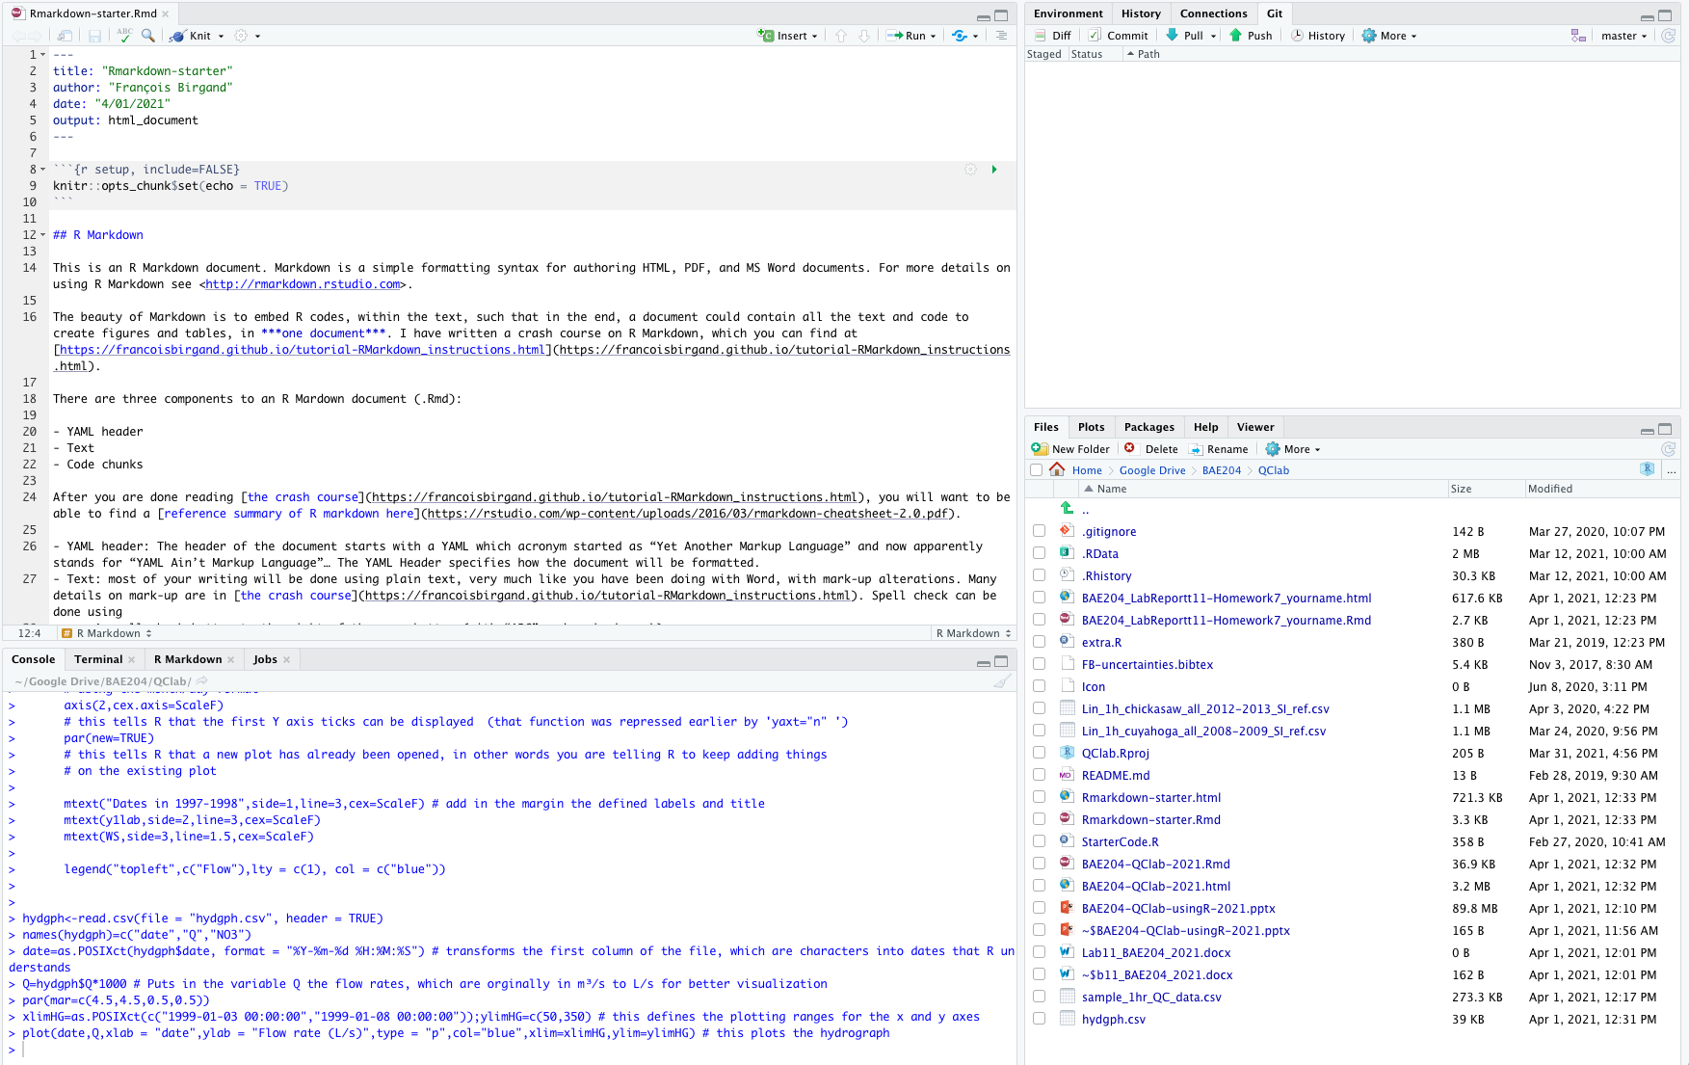

Slide 26
Downloading all necessary packages
In the right bottom window, you can see all the files in your working directory.
You can see several types of files:
*.Rmd: Rmarkdown files, where all your code and text are stored
*.yml: files that define the settings for the book and for the output
*.csv: files where I have data to draw tables
*.bib: files in which the info for cited references is stored
.gitignore: a file in which info of all the files and file types you do NOT want uploaded on Github are stored
*.css: files that define the html output formats
pictures directory: a directory where all the pictures are stored
docs directory: a directory where the all the rendered files are stored and ready for upload in Github
*.R script

Slide 27
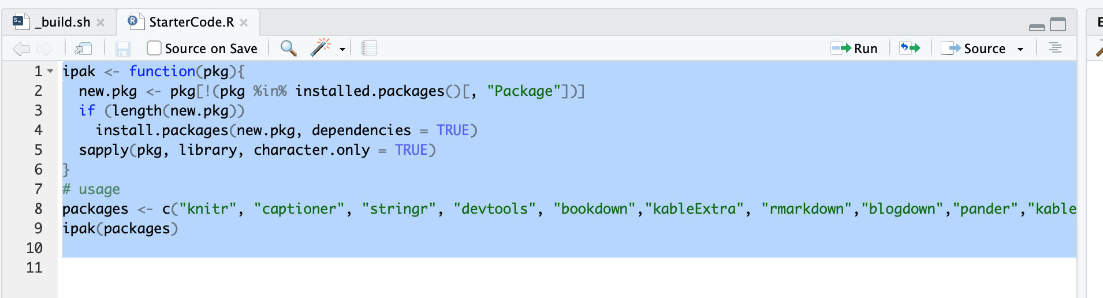
Downloading all necessary packages
Find in that window the StarterCode.R code, click on it
The left panel on the general view is now separated with a console at the bottom, and the file you just opened is at the top
Select all the text and click run

Slide 28
﻿Introduction to hydrographs, chemographs, concentrations, and loads

Slide 29
﻿Hydrograph

Slide 30
﻿Hydrograph

Slide 31
Characteristics of a hydrograph
An event is made of
Fast rising limb
Slower falling limb
Flow peak
Time of rise

Slide 32
Actual hydrograph over an entire year

Slide 33
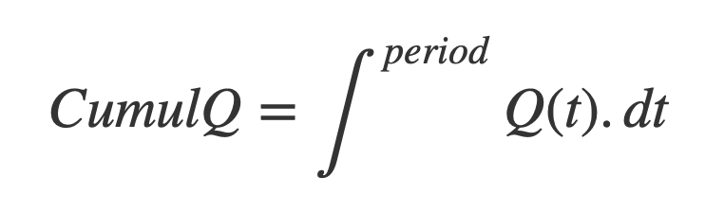

Calculating water fluxes or cumulative flow volumes

Slide 34
Calculating water fluxes or cumulative flow volumes

Slide 35
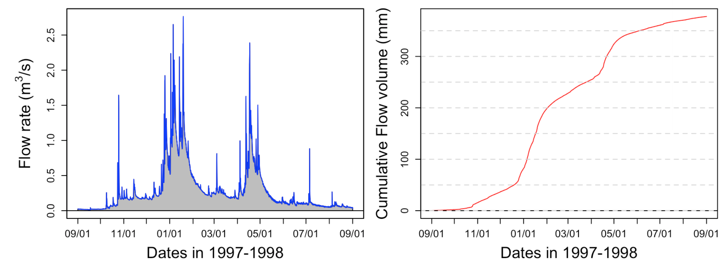
Calculating water fluxes or cumulative flow volumes

Slide 36
Flow duration curves
Evaluating the importance of rare high flow events
Flow duration curves represent the percentage of the total flow that occurred in x% of the time corresponding to the highest flows

Slide 37
Sorted flow rates

Slide 38
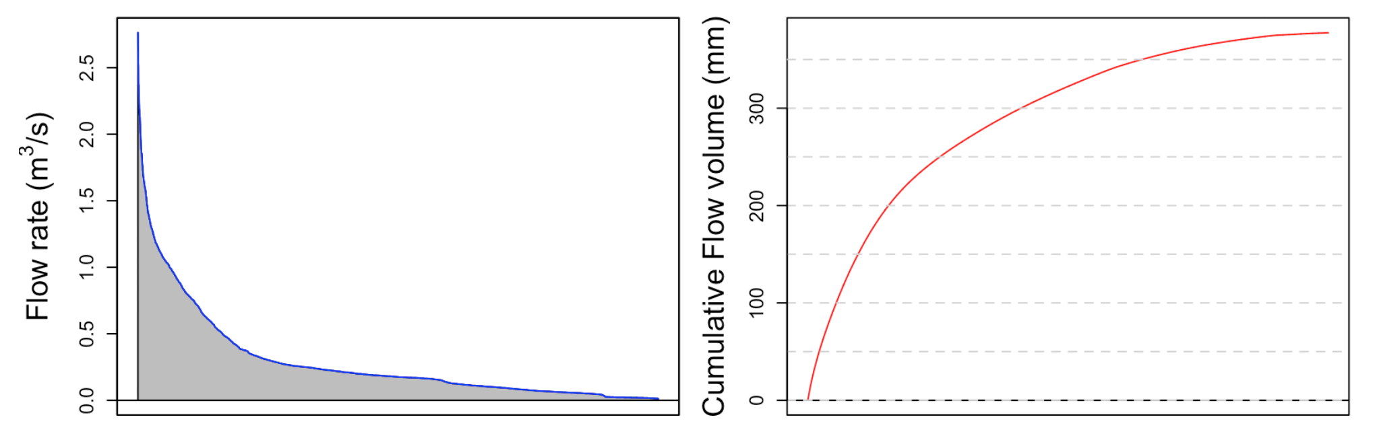
Integration under sorted flow rates

Slide 39
Flow duration curves

Slide 40
Flow duration curves
41%

Slide 41
Chemographs and concentration levels

Slide 42
Dilution effect

Slide 43
Concentration effect

Slide 44
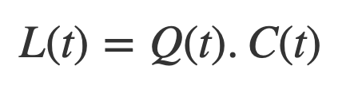
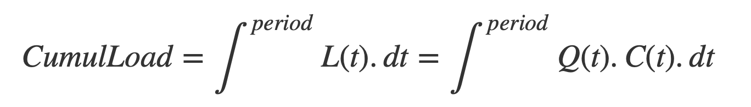
Cumulative Loads

Slide 45
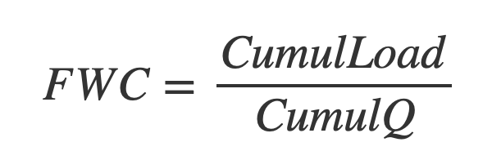
Arithmetic average vs Flow Weighted Average Concentration

Slide 46
Calculating loads without continuous concentrations
Load ~ Volume x arithmetic average
Underestimates loads when concentration effect
Overestimates loads when dilution effect

Slide 51
Arithmetic average vs Flow Weighted Average Concentration

